Slide 1
Deep Reward
정원석

Slide 2

Master Algorithm?
Function

Slide 3

Master Algorithm?
Deep Learning

Slide 4

Interactions
Reinforcement Learning

Slide 5
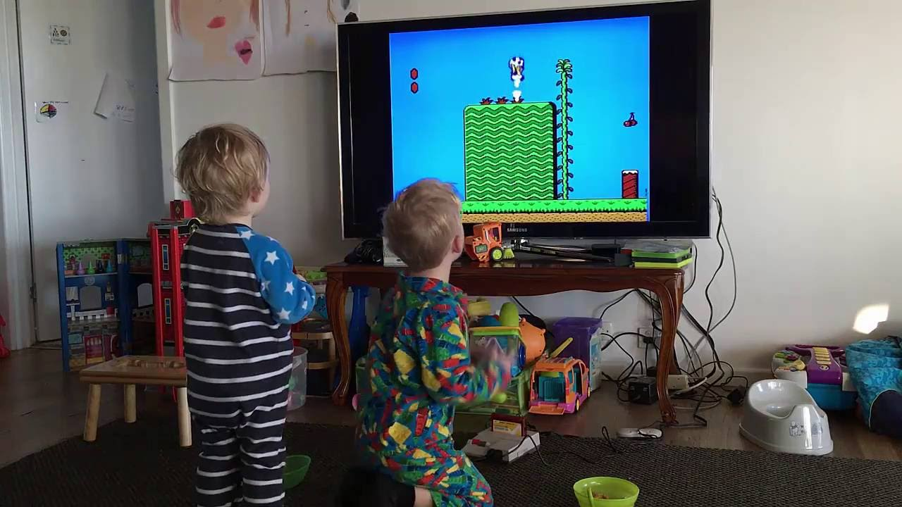
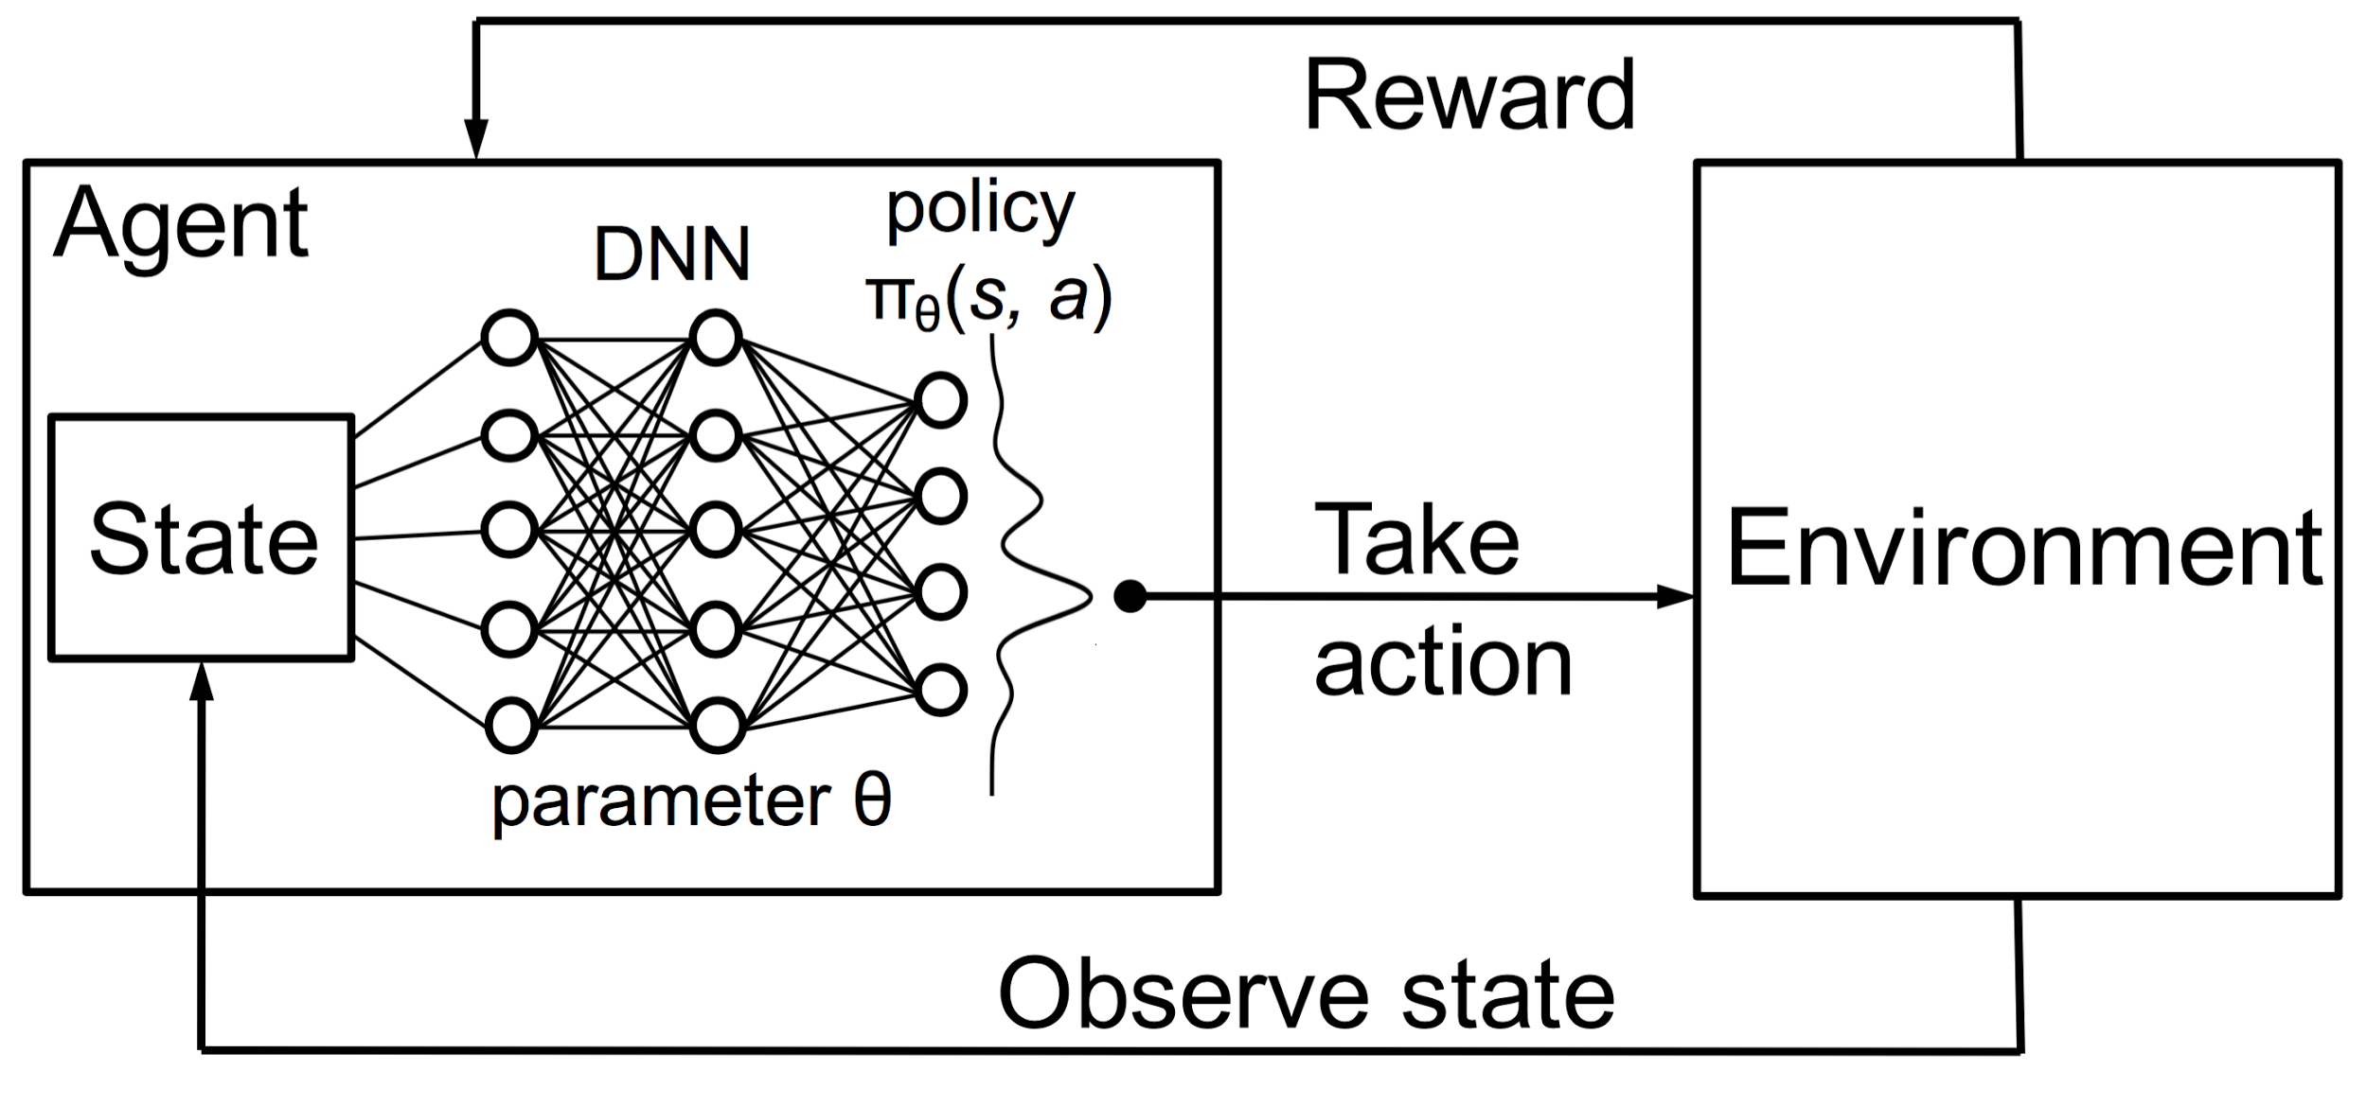
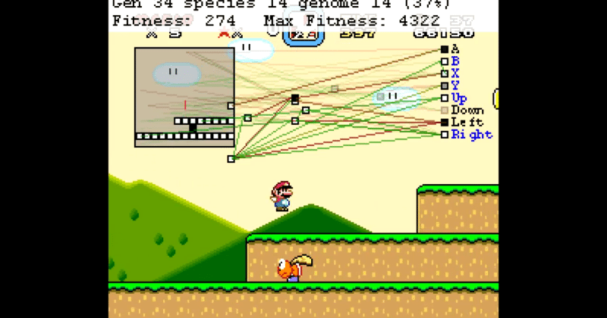
Human,A.I. and Deep Reinforcement Learning
Deep Reinforcement Learning
Human
A.I.

Slide 6
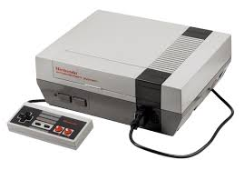
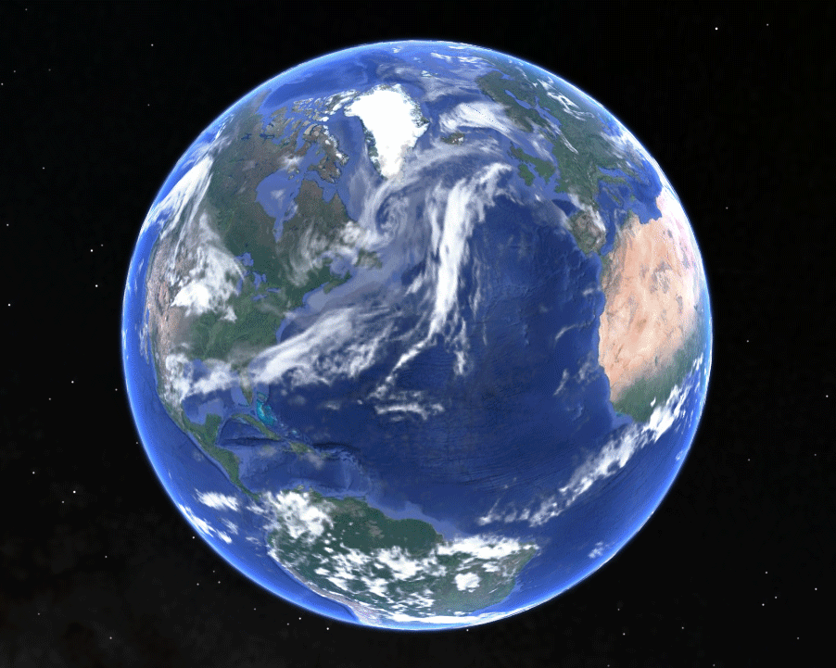
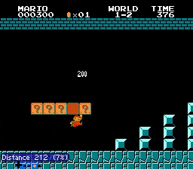
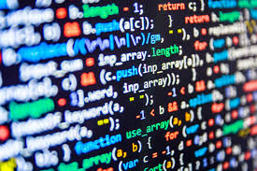
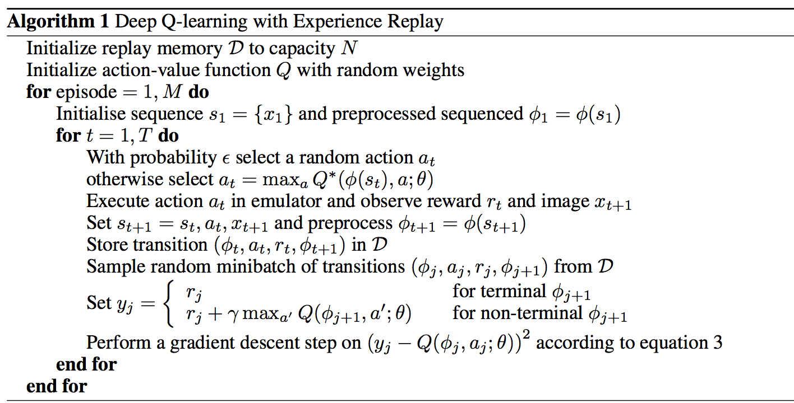
4 things you need to make an A.I. Super Mario:
Emulator
Environment
Programming Language
Algorithm

Slide 7




Programming Language - Python
https://www.python.org/downloads/ - 3.x version
https://www.anaconda.com/download/ -Anaconda
https://www.tensorflow.org/install/ - TensorFlow
https://keras.io/#installation -Keras
Notes:
Sudo apt-get update
Sudo apt-get install fceux
Sudo apt-get install mpich
Sudo pip3 install mpi4py
Pip3 install baselines

Slide 8
Emulator - FCEUX
Emulator
http://www.fceux.com/web/home.html
Ubuntu
sudo apt-get update
sudo apt-get install fceux
MAC
https://brew.sh/ -homebrew website
Terminal open -> brew install fceux
sudo apt-get install fceux

Slide 9

Environment - Super Mario
OpenAI_Gym
https://github.com/openai/gym
pip3 install gym
OR
git clone https://github.com/openai/gym.git cd gym pip install -e .
Baselines
https://github.com/openai/baselines
pip3 install baselines
OR
git clone https://github.com/openai/baselines.git cd baselines pip install -e .
Environment

Slide 10

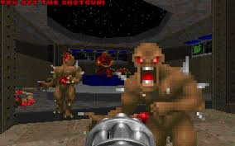
Environment - Super Mario-2
Philip Paquette
https://github.com/ppaquette/gym-super-mario
pip3 install gym-pull
import gym import gym_pull gym_pull.pull('github.com/ppaquette/gym-super-mario') env = gym.make('ppaquette/SuperMarioBros-1-1-v0')
Environment
Notes:
https://github.com/ppaquette/gym-super-mario

Slide 11
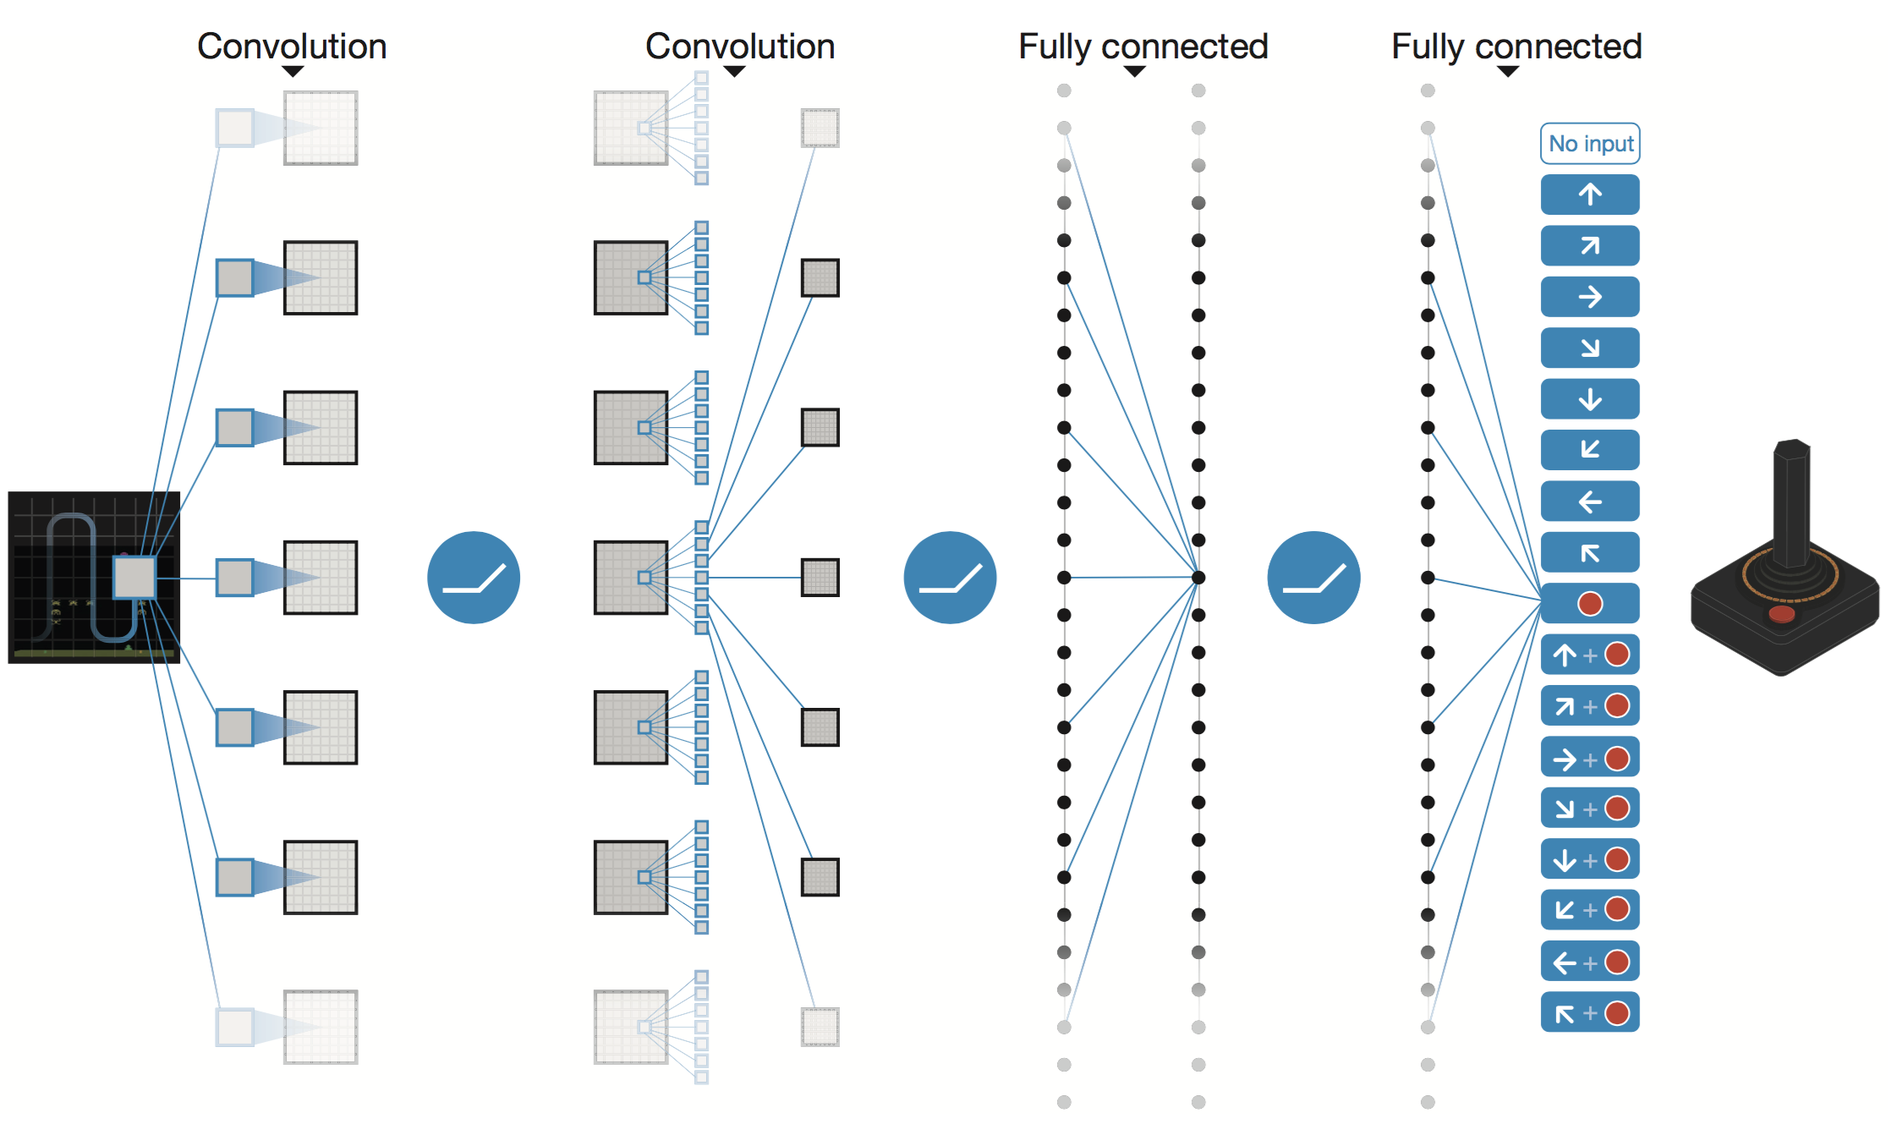

Algorithm - DQN
Algorithm
DEEP Q-NETWORK
Notes:
https://www.cs.toronto.edu/~vmnih/docs/dqn.pdf

Slide 12
First episode

Slide 13
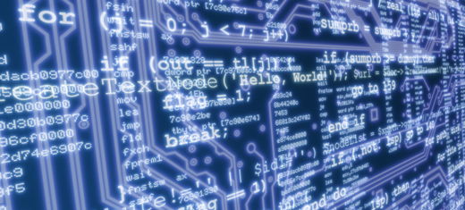
Computing power
60sec x 1,000,000 = 60,000,000 sec
694 DAYS

Slide 14
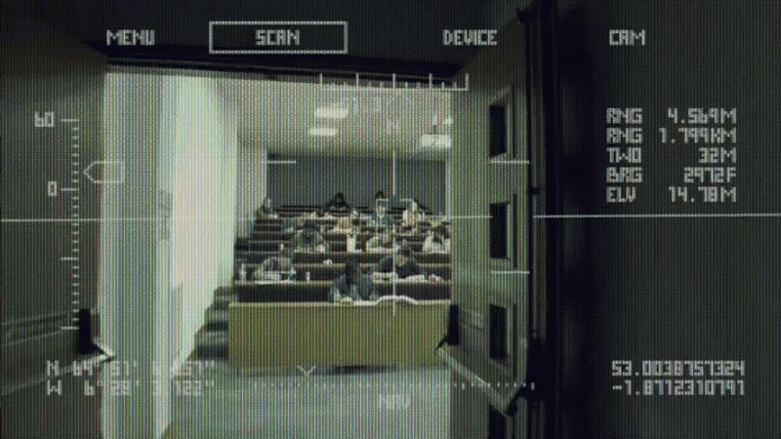
The future of Reinforcement Learning?

Slide 15
References
https://github.com/wonseokjung/Supermario_Reinforcement_WS
https://deepmind.com/
https://github.com/openai/gym
https://github.com/ppaquette/gym-super-mario
Notes:
https://www.cs.toronto.edu/~vmnih/docs/dqn.pdf

